Slide 1
BCI Competition IV
2008
分享人：周晴

Slide 2
BCI Competition IV
Data sets 1: ‹motor imagery, uncued classifier application›
EEG, motor imagery (2 classes of left hand, right hand, foot); evaluation data is continuous EEG which contains also periods of idle state
Data sets 2a: ‹4-class motor imagery›
EEG, cued motor imagery (left hand, right hand, feet, tongue)
Data sets 2b: ‹motor imagery›
EEG, cued motor imagery (left hand, right hand)
Data sets 3: ‹hand movement direction in MEG›
Data sets 4: ‹finger movements in ECoG›

Slide 3
Data sets 1 motor imagery, uncued classifier application
[64 EEG channels (0.05-200Hz), 1000Hz sampling rate, 2 classes (+ idle state), 7 subjects]
每个被试三选二（左手、右手、脚）
校准data
2 runs 视觉提示（箭头左右下） 有标签 4s
评估data
4 runs 声音提示（左、右、脚、停止）无标签
运动想象和休息持续时间都在1.5s到8s之间
每个条件的trial数不一定相等
部分数据是人工生成的
具有特定的属性，用来评估和比较分析技术
Notes:
分类器连续地应用于传入的EEG，而不需要被试切换意图的提示。
该数据集没有提示信息。用户没有控制意图时，分类器应该返回0。
generating artifical EEG signals with specified properties that is such realistic that it can be used to evaluate and compare analysis techniques.

Slide 4
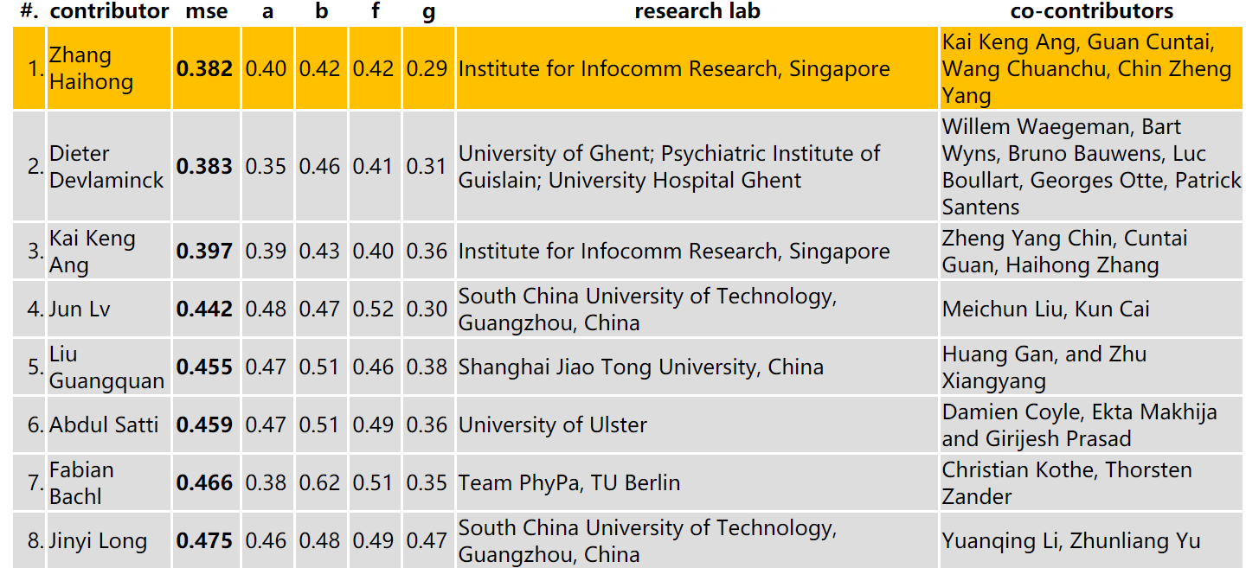
Data sets 1 Results
性能评估：针对目标向量的均方误差（mse）
类1标为-1 放松标为0 类2标为1
Notes:
包含开始提示后1s到停止提示
c d e 人为生成

Slide 5
Data sets 1 Results
Zhang Haihong, Institute for Infocomm Research, Singapore
Clustering after PCA or ICA to get a rest class; CSP on multiple bands; mutual information based feature selection; radial basis function based neural network
Dieter Devlaminck, University of Ghent; Psychiatric Institute of Guislain; University Hospital Ghent
Band-pass filtering, multiclass CSP, multiclass SVM with ordinal regression, smoothing
Kai Keng Ang, Institute for Infocomm Research, Singapore
CSP on multiple bands; mutual information based feature selection; Naive Bayes Parzen Window classifier

Slide 6
Data sets 1 Results
Jun Lv, South China University of Technology, Guangzhou, China
CSP-based method
Liu Guangquan, Shanghai Jiao Tong University, China
CSP in frequency bands that were optimized by cross-validation; log-variance; LDA
Abdul Satti, University of Ulster
Selection of frequency bands by particle swarm optimization; selection of time intervals by corss-validation; CSP with specific filter selection; log-variance; LDA; smoothing

Slide 7
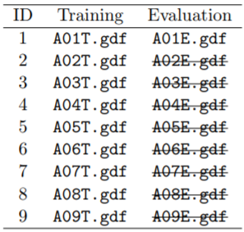
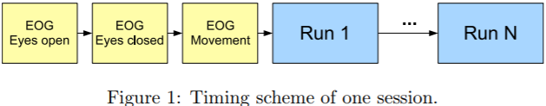
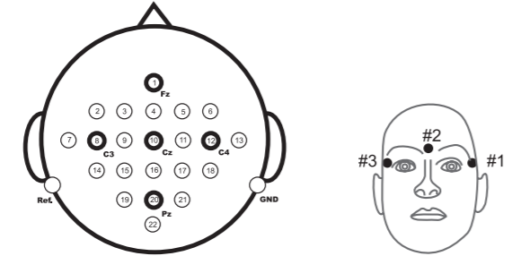
Data sets 2a 4-class motor imagery
[22 EEG channels (0.5-100Hz; notch filtered), 3 EOG channels, 250Hz sampling rate, 4 classes, 9 subjects]
4类运动想象（类1：左手 | 类2：右手 | 类3：双脚 | 类4：舌头）
2 sessions 视觉提示（箭头方向） 无反馈
T打标签做训练集
E不打标签做测试集
6 runs * 48 trials（每类12 trials）= 288 trials per session
22 EEG channels
3 monopolar EOG channels
Notes:
五分钟 ： 两分钟的眼睛睁开(看屏幕上的一个固定的十字)(2)一分钟闭上眼睛(3)一分钟的眼球运动。

Slide 8
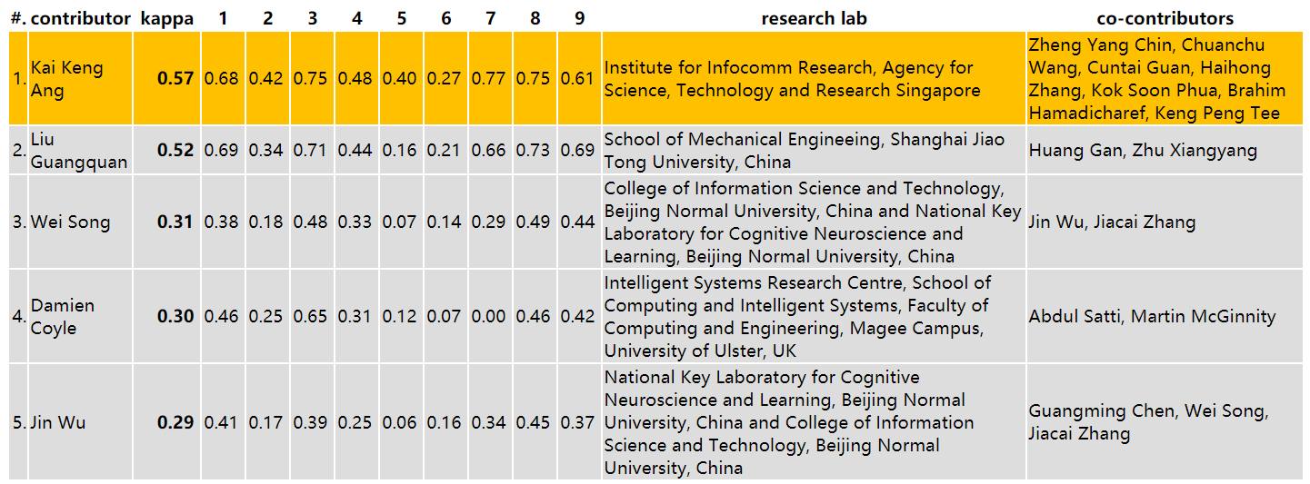
Data sets 2a Results
0
kappa值
1
性能评估：kappa值
如果分类是随机的，那么kappa值是0
低
一致性
高
Notes:
Kappa用来评价一个分类器的准确性，特别是在标签不平衡的状态下
kappa计算结果为-1~1，但通常落在 0~1 间，可分为五组来表示不同级别的一致性：
0.0~0.20极低的一致性(slight)
0.21~0.40一般的一致性(fair)
0.41~0.60 中等的一致性(moderate)
0.61~0.80 高度的一致性(substantial)
0.81~1几乎完全一致(almost perfect)

Slide 9

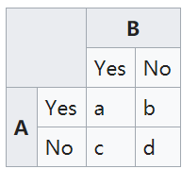


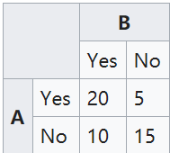


kappa
用来评价一个分类器的准确性，特别是在标签不平衡的状态下
observed proportionate agreement
expected probability

Slide 10
Data sets 2a Results
Kai Keng Ang, Institute for Infocomm Research, Agency for Science, Technology and Research ，Singapore
Preprocessing: Artifact removal with bandpass filter.
Features: Filter Bank CSP (FBCSP) using multiple one-against-the-rest classifiers.
Classification: Naive Bayes Parzen Window classifier.
Liu Guangquan, School of Mechanical Engineeing, Shanghai Jiao Tong University, China
Preprocessing: CSP on bandpass-filtered data (between 8-30Hz).
Features: Log variance of best eight components.
Classification: LDA and Bayesian classifier.

Slide 11
Data sets 2a Results
Wei Song, Beijing Normal University, China
Preprocessing: Downsampling, EOG removal with linear regression, bandpass filter between 8-25Hz and select channels based on a recursive channel elimination.
Features: CSP.
Classification: Ensemble multi-class classifier using three SVM classifiers with two hierarchies and combination through voting strategy.
Damien Coyle, University of Ulster, UK
Preprocessing: CSP on spectrally filtered Neural Time Series Prediction Preprocessing (NTSPP) signals.
Features: Log variance of each filtered channel is calculated with a one second sliding window.
Classification: The best classifier among 3 variants of LDA and 2 variants of SVM was chosen for each subject individually.

Slide 12
Data sets 2b motor imagery
[3 bipolar EEG channels (0.5-100Hz; notch filtered), 3 EOG channels, 250Hz sampling rate, 2 classes, 9 subjects]
类1：左手 | 类2：右手
5 sessions
前两个session屏幕显示（指左或右的箭头）、无反馈
6 runs * 20 trials（左右各10 trials）= 120 trials per session
后三个session有反馈
4 runs * 40 trials（左右各20 trials）= 120 trials per session
前三个session含类标签，后两个session无标签，用于测试评估
Notes:
bipolar EEG channels 双极型EEG通道
3 bipolar recordings(C3, Cz, and C4)

Slide 13
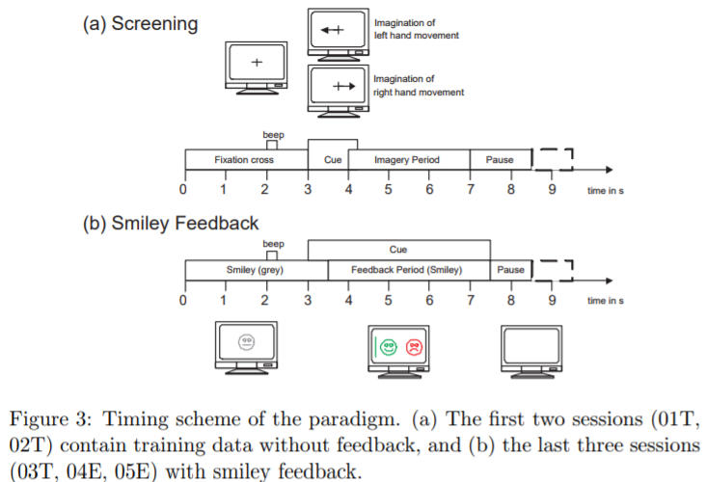
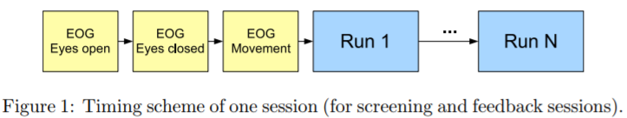
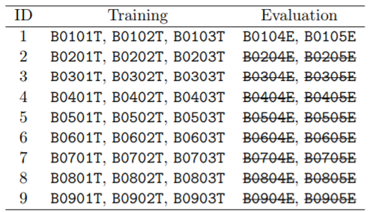
Data sets 2b motor imagery

Slide 14
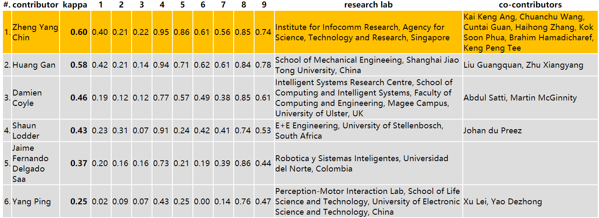
Data sets 2b Results
0
kappa值
1
性能评估：kappa值
如果分类是随机的，那么kappa值是0
低
一致性
高
Notes:
kappa计算结果为-1~1，但通常落在 0~1 间，可分为五组来表示不同级别的一致性：
0.0~0.20极低的一致性(slight)
0.21~0.40一般的一致性(fair)
0.41~0.60 中等的一致性(moderate)
0.61~0.80 高度的一致性(substantial)
0.81~1几乎完全一致(almost perfect)

Slide 15
Data sets 2b Results
Zheng Yang Chin, Institute for Infocomm Research, Agency for Science, Technology and Research, Singapore
Preprocessing: Artifact removal with bandpass filter.
Features: Filter Bank CSP (FBCSP) using multiple one-against-the-rest classifiers.
Classification: Naive Bayes Parzen Window classifier.
Huang Gan, Shanghai Jiao Tong University, China
Preprocessing: Bandpass filtering in different frequency band, EOG removal.
Features: Common spatial subspace decomposition (CSSD).
Classification: LDA.

Slide 16
Data sets 2b Results
Damien Coyle, University of Ulster, UK
Preprocessing: CSP on spectrally filtered Neural Time Series Prediction Preprocessing (NTSPP) signals.
Features: Log variance of each filtered channel is calculated with a one second sliding window.
Classification: The best classifier among 3 variants of LDA and 2 variants of SVM was chosen for each subject individually.
Shaun Lodder, University of Stellenbosch, South Africa
Preprocessing: N/A.
Features: Wavelet packet transform using only C3 and C4. Selected frequency bands were extracted and concatenated to form a multidimensional vector.
Classification: LDA.

Slide 17
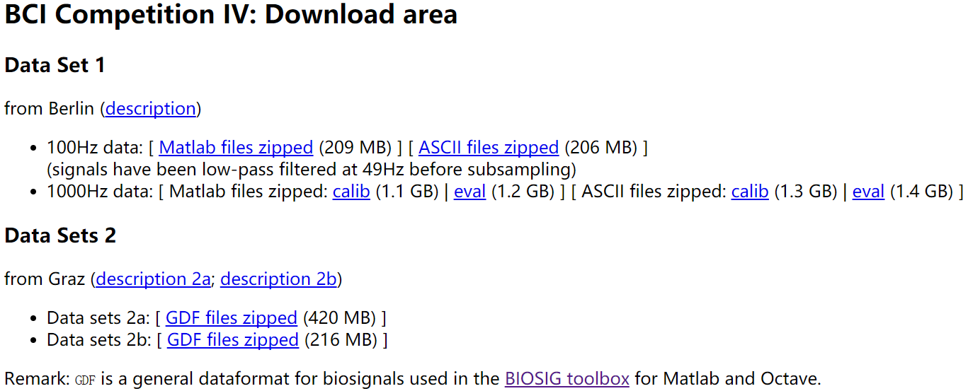
Download dataset

Slide 18
PCA CSP
PCA的本质是 对角化 协方差矩阵
CSP的本质是同时对角化 两类协方差矩阵

Slide 19

PCA
PCA的本质是 对角化 协方差矩阵
目的——“降噪”&“去冗余”
“降噪”：使保留下来的维度间的相关性尽可能小，
“去冗余”：使保留下来的维度含有的“能量”即方差尽可能大
协方差矩阵
主对角线上的元素是各个维度上的方差(即能量)
其他元素是两两维度间的协方差(即相关性)
降噪——矩阵对角化
非对角线元素都为零
去冗余——舍掉对角线上较小的新方差
协方差矩阵
Notes:
方差：分散程度

Slide 20
白化
将一组样本的协方差矩阵转换为单位矩阵的去相关方法
减少特征之间的相关性；
特征具有相同的方差（协方差阵为1）
对观测信号X(t)，寻找一个线性变换W₀，使X(t)投影到新的子空间后变成白化向量Z(t)，即 Z(t)=W₀ * X(t)
构造白化变换矩阵：
W₀= λ^{-1/2}U^{T}
λ 是特征值对角阵，U是特征向量矩阵

Slide 21





CSP_{(from wiki)}
两类矩阵 X₁ (n,t₁) X₂ (n,t₂)
寻找使方差(或二阶矩)的比值最大化的成分W
协方差矩阵R₁ R₂：
同时对角化（存在同一个矩阵P，使R₁ R₂ 对角化）
最终结果：
其中I_{n}是单位矩阵

Slide 22
CSP_{（from EEG特征提取算法文献）}
原始EEG信号X（N x T）
归一化的协方差矩阵C₁ C₂
特征值分解
（对角化）
求和C
特征向量矩阵U
特征值对角阵λ
主成分分析，得到特征值λ₁ λ₂
变换得到S₁ S₂
构造
白化变换矩阵P
取λ₁中前m个最大的特征值
λ₂中前n个最大的特征值
S₁ S₂特征向量相同
Notes:
n 通道数 t 采样点数

Slide 23
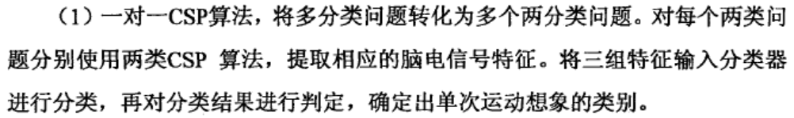
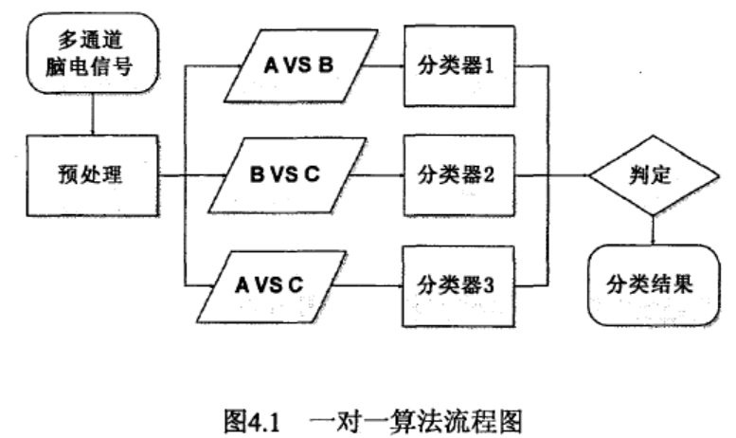
CSP_{（from EEG特征提取算法文献）} _{多分类问题}

Slide 24
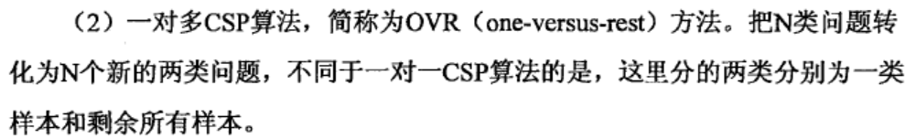
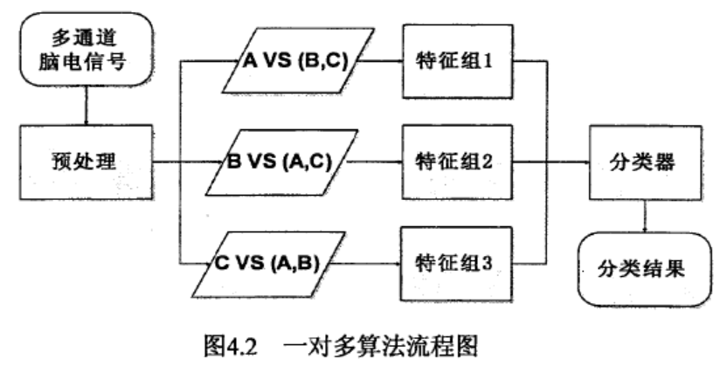
CSP_{（from EEG特征提取算法文献）} _{多分类问题}

Slide 25
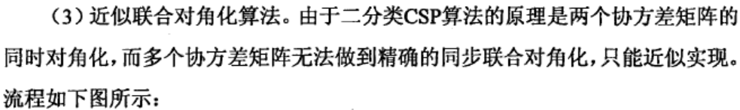
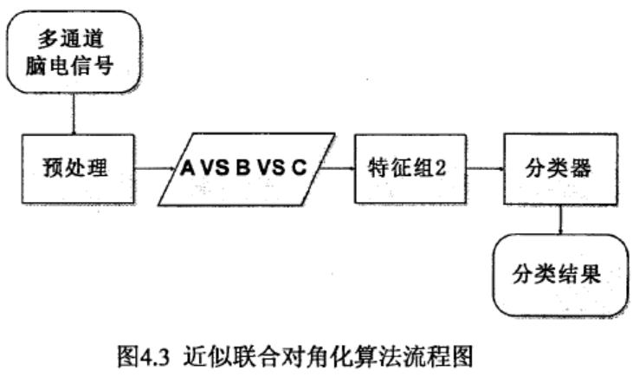
CSP_{（from EEG特征提取算法文献）} _{多分类问题}

